Slide 1

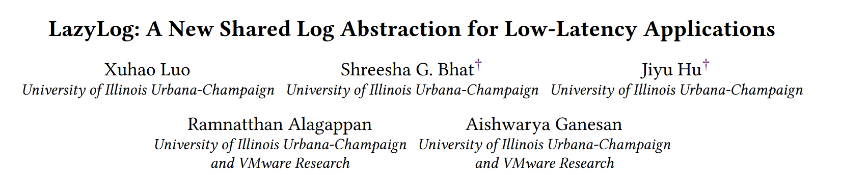

Slide 2
INTRODUCTION
Background
Shared logs have emerged as a crucial building block for datacenter applications.
At its core, a shared log is a fault-tolerant, ordered sequence of records that many clients can simultaneously operate on.

Slide 3
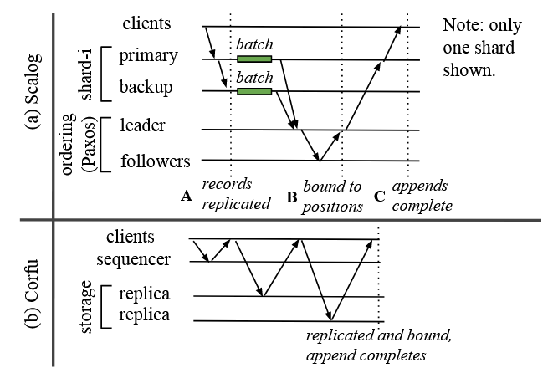
INTRODUCTION
Background
Today’s shared logs incur high latencies because they eagerly order records in the critical path before acknowledging appends.
Low-latency ingestion, however, is critical for many real-world shared-log applications.
Notes:
A阶段类似2PC（持久化前的阶段），等到C阶段完成结果才对全局可见

Slide 4
INTRODUCTION
Insight
In many shared-log applications, while linearizable order is necessary, it is not required right away upon ingestion but only later during reads.
Readers and writers in these applications are naturally decoupled in time.
This allows a shared log to establish the order in the background after acknowledging appends but before reads arrive.

Slide 5
INTRODUCTION
Abstraction
In LazyLog, appending a record does not eagerly bind it to a log position; it only provides durability and a guarantee that the record will be eventually bound to its correct position that respects linearizability.
LazyLog preserves the ordering guarantees of the conventional shared log abstraction and enforces the correct order before reads.
While conventional logs incur ordering cost upon appends, LazyLog shifts this cost to reads.

Slide 6
INTRODUCTION
Systems
We build two systems that implement the LazyLog abstraction: Erwin-■ (black-box) and Erwinst (scalable throughput).
Both systems write enough information about the records on a fault-tolerant sequencing layer, using which the order can be established in the background.

Slide 7
INTRODUCTION
Systems
Erwin-■ (§4) aims to work with unmodified shards. It writes the record only to the sequencing layer, which then orders and pushes the records to shards in the background.
Erwin-st (§5) alleviates the bottleneck of the sequencing layer by writing only metadata that identifies the records to the sequencing layer and the actual records directly to the shards.
The two versions show that the LazyLog abstraction can be implemented in disparate shared log architectures.

Slide 8
CONTRIBUTION
We make new observations about modern shared-log applications that present a new opportunity for a shared log to defer ordering, enabling low-latency ingestion.
We present LazyLog, a novel shared log abstraction that builds upon this opportunity.
We design two LazyLog systems, Erwin-■ and Erwin-st, that lazily establish global order, and avoid ordering cost within shards.

Slide 9
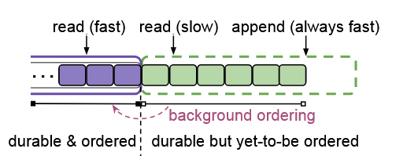
ABSTRACTION
Makespan
If a read accesses the ordered portion, it is served quickly.
Conversely, if a read accesses positions in the unordered portion, it takes a slow path: it is served after establishing the order at least up to the requested position.
Notes:
if the records are ordered in large batches (in the background) , then only the first read to the unordered portion would incur overhead

Slide 10
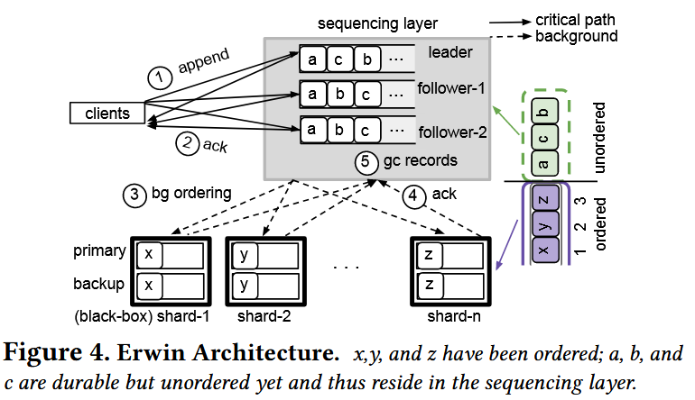
Erwin-■ Design
Overview
Erwin(Erwin-■) requires shards to support the following operations: append an entry and read the entry at a specified index.
Notes:
if the records are ordered in large batches (in the background) , then only the first read to the unordered portion would incur overhead

Slide 11
Erwin-■ Design
Path
directly write the records to the sequencing-layer replicas in parallel;
get responses from all sequencing replicas;
-- Append completes here
establishes the linearizable order and pushes the records to the shards in background;
stores the records and acknowledges;
discards pushed rcords.
Notes:
if the records are ordered in large batches (in the background) , then only the first read to the unordered portion would incur overhead

Slide 12
Erwin-■ Design
Ordering
Because there is no cross-replica coordination in the sequencing layer, records from clients could appear in different orders across the replicas.
Only records that are concurrently appended may (but not necessarily) appear in different orders across the logs.
Erwin treats one of the sequencing replicas as the leader and others as followers to determine the order of concurrent records.
Notes:
if the records are ordered in large batches (in the background) , then only the first read to the unordered portion would incur overhead

Slide 13
Erwin-■ Design
Establishing the Order
The sequencing leader assigns records to positions (according to its local log) and pushes them to the appropriate shards.
Once safe on the shards, the records are garbage collected at the sequencing replicas.
The shards can then safely serve reads to positions up to this safe record.
Notes:
if the records are ordered in large batches (in the background) , then only the first read to the unordered portion would incur overhead

Slide 14
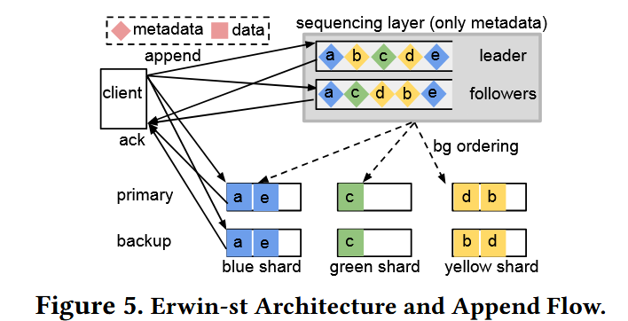
Erwin-st Design
Overview
Erwin-st’s main idea is to split a record into data and a piece of metadata that identifies the record. Clients then write record-data to the shards directly and only the metadata to the sequencing layer.
Notes:
if the records are ordered in large batches (in the background) , then only the first read to the unordered portion would incur overhead

Slide 15
Erwin-st Design
Background Ordering
The sequencing leader tries to establish the order of records by assigning metadata identifiers to positions; it then pushes the metadata along with the assigned positions to the shard primaries.
Readers determine whether the record is ordered in the shard by checking the metadata log.
Notes:
if the records are ordered in large batches (in the background) , then only the first read to the unordered portion would incur overhead

Slide 16
EVALUATION
Question
Performance:
What are the latency benefits of a lazy-ordering shared log compared to eagerly ordering shared logs?
How do reads perform in a lazy-ordering shared log compared to an eagerly ordering one?
How well does Erwin-st scale compared to Erwin-■?
Affect factor:
How does the append rate impact read latency?
How does record size impact Erwin-■’s throughput?

Slide 17
EVALUATION
Setup
A cluster with five shards.
The sequencing layer has three replicas (one leader and two followers)

Slide 18
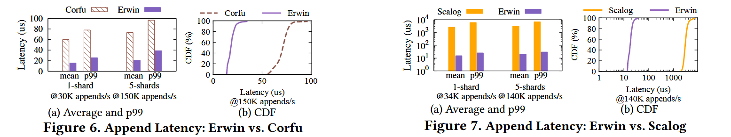
EVALUATION
Benefit of Lazy Ordering
Erwin hides shard-internal coordination latency and also defers global ordering, offering low latency.

Slide 19
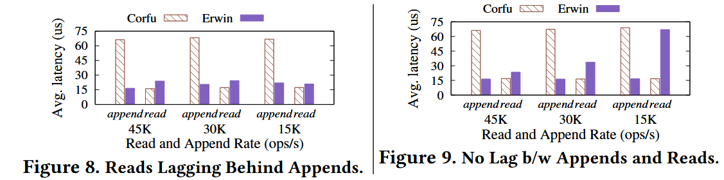
EVALUATION
Read Latencies
Erwin pushes the latency of ordering before read, so it can use the time interval between append and read without addition latency.

Slide 20
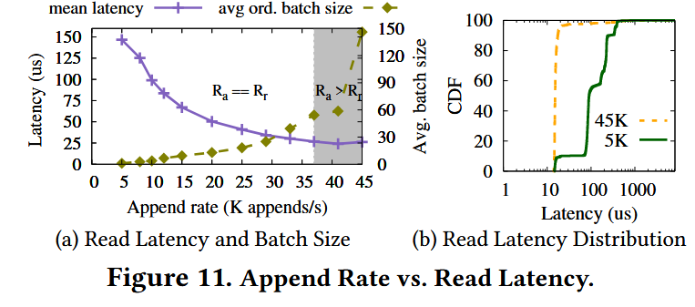
EVALUATION
Impact of Append Rate
When read slowly, by the time a log position is read, the records are already ordered. Thus, almost all reads take the fast path, resulting in low latencies.
The latency decreases when append rate grows because the background-ordering batch sizes becomes larger.

Slide 21
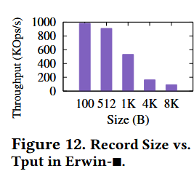
EVALUATION
Impact of Record Size
Because data itself passes through the sequencing layer, it quickly becomes the throughput bottleneck, limiting Erwin-■’s throughput with larger records.

Slide 22
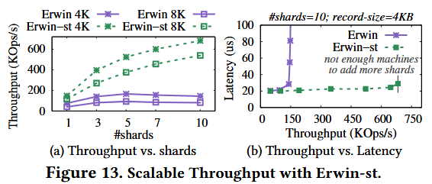
EVALUATION
Scalability
Erwin-st achieves high throughput with low latencies because Erwin-st writes metadata and data without any coordination in 1RTT.
It performs better than Erwin-■ because it only writes metadata to the sequencing layer(bottleneck).

Slide 23
CONCLUSION
Eager ordering is unnecessary and order can be enforced later upon reads.
Linearizable total order across shards can be achieved in a shared log system with low ingestion latencies and little to no overhead upon reads.

Slide 24
Limitation
Both systems scale with shards and are limited by the sequencing-layer.
LazyLog systems may not suit applications where writers need to know their records’ positions immediately.
Notes:
if the records are ordered in large batches (in the background) , then only the first read to the unordered portion would incur overhead

